Slide 1
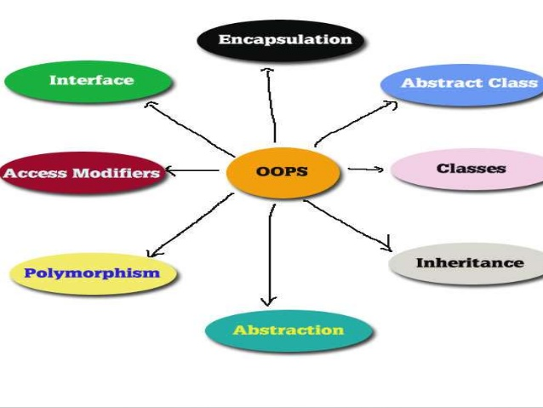
Object Oriented Programming & Design
Session – 3: 14-Oct-2018
Notes:
NOTE:
To change the image on this slide, select the picture and delete it. Then click the Pictures icon in the placeholder to insert your own image.

Slide 2

Agenda
Sample Java Exercises
  Variables
  Methods
Arrays Revisited
Strings

Slide 3

EXERCISES
Sample Exercises on Classes & Methods

Slide 4
Recap
1. What is stored in the object obj in following lines of code?
box obj;
a) Memory address of allocated memory of object.
b) NULL
c) Any arbitrary pointer
d) Garbage
2. Which of the following is a valid declaration of an object of class Box?
  a) Box obj = new Box();
  b) Box obj = new Box;
  c) obj = new Box();
  d) new Box obj;
Answer: b
Explanation: Memory is allocated to an object using new operator. box obj; just declares a reference to object, no memory is allocated to it hence it points to NULL.
Answer: a
Explanation: Not Required (-:

Slide 5
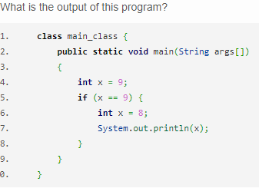
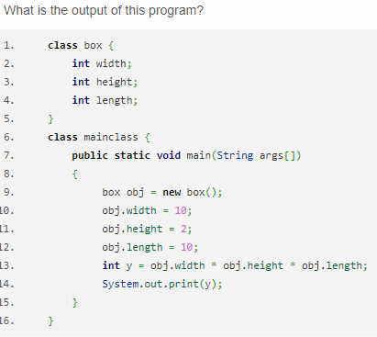
Recap: What is the O/P?
Explanation: Two variables with the same name can’t be created in a class.
output:
$ javac main_class.java
Exception in thread “main” java.lang.Error: Unresolved compilation problem:
Duplicate local variable x
Answer: 200
Explanation: Not Required (-:

Slide 6
Recap
Which of these statement is incorrect?
a) All object of a class are allotted memory for the all the variables defined in the class.
b) If a function is defined public it can be accessed by object of other class by inheriting.
c) main() method must be made public.
d) All object of a class are allotted memory for the methods defined in the class.
Which of the following is a method having same name as that of it’s class?
a) finalize
b) delete
c) class
d) constructor
Answer: d
Explanation: Not Required (-:
Answer: d
Explanation: Not Required (-:

Slide 7
Recap
Which function is used to perform some action when the object is to be destroyed?
a) finalize()
b) delete()
c) main()
d) None of the mentioned
Which keyword is used by method to refer to the object that invoked it?
a) import
b) catch
c) abstract
d) this
Answer: a
Explanation: Not Required (-:
Answer: d
Explanation: Not Required (-:

Slide 8
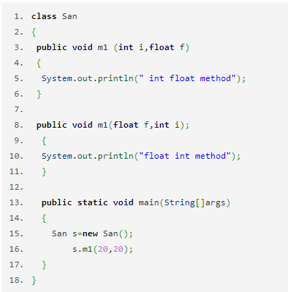
Recap: What is the O/P?
Which operator is used by Java run time implementations to free the memory of an object when it is no longer needed?
a) delete
b) free
c) new
d) None of the mentioned
Answer: Compile time error
Explanation: Automatic promotion is confusing here..
Answer: d
Explanation: GC is called internally by the JVM

Slide 9
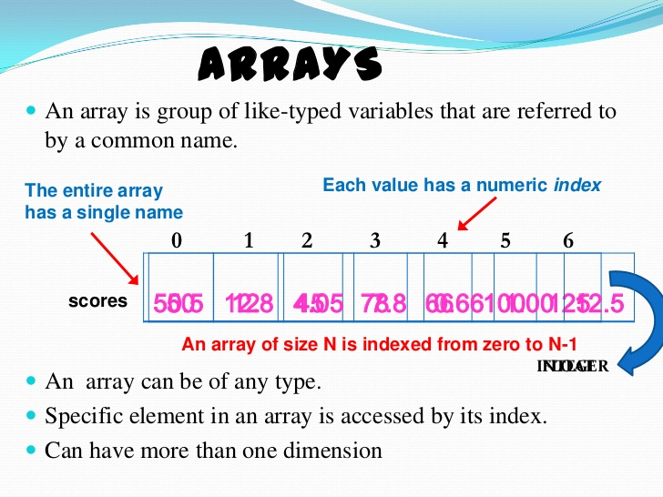
Java-Arrays
Birds of a feather flock together!

Slide 10
Array Revisited - Introduction.
Java provides a data structure, the array, which stores a fixed-size sequential collection of elements of the same type.
An array is a group of like-typed variables that are referred to by a common name.
Arrays of any type can be created and may have one or more dimensions.
A specific element in an array is accessed by its index.
Arrays offer a convenient means of grouping related information.
A one-dimensional array is, essentially, a list of like-typed variables. To create an array, you first must create an array variable of the desired type. The general form of a one-dimensional array declaration is
  type var-name[ ]; (OR)
  Type[] var-name;

Slide 11
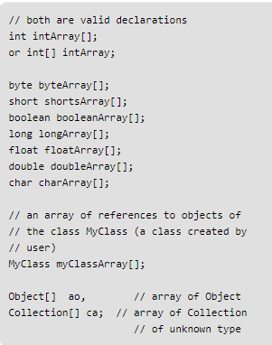
Array Revisited – Assigning & Instantiation.
Although the above first declaration establishes the fact that intArray is an array variable, no array actually exists.
It simply tells to the compiler that this(intArray) variable will hold an array of the integer type.
To link intArray with an actual, physical array of integers, you must allocate one using new and assign it to intArray.
When an array is declared, only a reference of array is created.
To actually create or give memory to array, you create an array like this: var-name = new type [size];
int intArray[]; //declaring array
intArray = new int[20]; // allocating memory to array
      (OR)
Int[] intarray = new int[20]

Slide 12
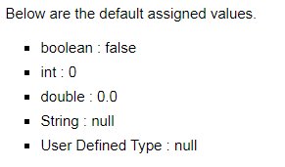
Array Revisited – Assigning & Instantiation.
When space for an array is allocated, the array size must be given, to specify the number of elements that can be stored in it.
The size of an array cannot be changed after the array is created. Size can be obtained using arrayRefVar.length. For example, intarray.length is 20.
When an array is created, its elements are assigned the default value of 0 for the numeric primitive data types, '\u0000' for char types, and false for Boolean types.
The array elements are accessed through the index. Array indices are 0-based; that is, they start from 0 to arrayRefVar.length-1.
Each element in the array is represented using the following syntax, known as an indexed variable:

Slide 13
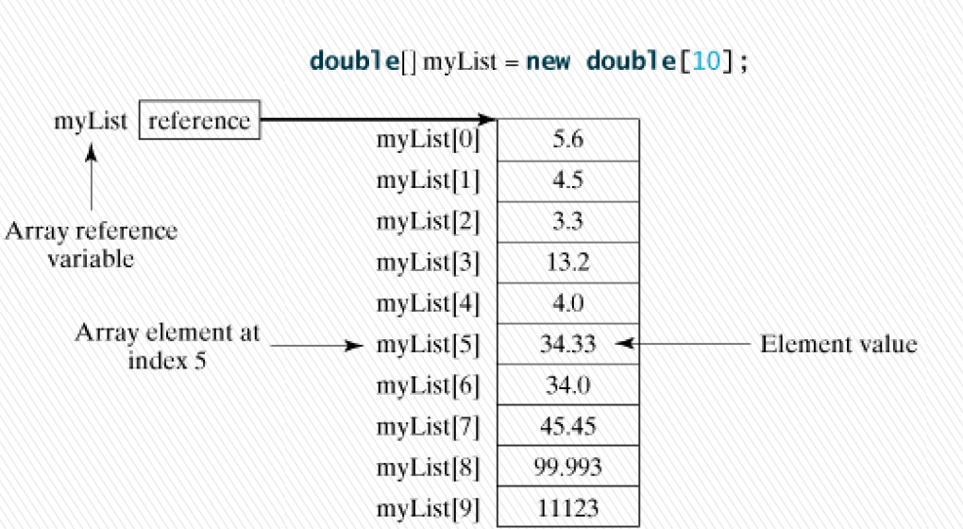
Array Revisited - Representation.

Slide 14
Array Initializer.
Java has a shorthand notation, known as the array initializer, which combines
  declaring an array,
  creating an array, and
  initializing in one statement
using the following syntax: dataType[] arrayRefVar= {value0, value1, ..., valuek};
For example: double[] myList = {1.9, 2.9, 3.4, 3.5};
This statement declares, creates, and initializes the array myList with four elements, which is equivalent to the statements shown below:
  double[] myList= new double[4];
  myList[0] = 1.9;
  myList[1] = 2.9;
  myList[2] = 3.4;
  myList[3] = 3.5;

Slide 15
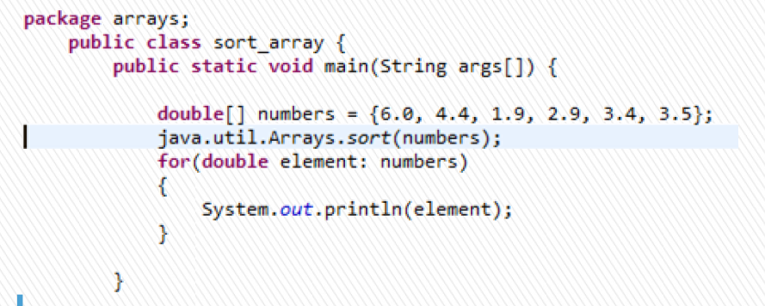
Array Processing: Array Class
The java.util.Arrays class contains various static methods for sorting and searching arrays, comparing arrays, and filling array elements. These methods are overloaded for all primitive types.
»You can use the sort method to sort a whole array or a partial array. For example, the following code sorts an array of numbers and an array of characters:

Slide 16
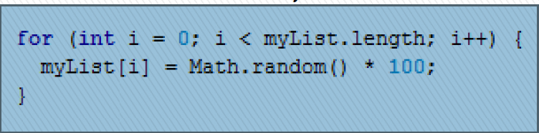
Array Processing.
When processing array elements, you will often use a for loop. Here are the reasons why:
Since the size of the array is known, it is natural to use a for loop.
Here are some examples of processing arrays:
(Initializing arrays with random values)
The following loop initializes the array myList with random values between 0.0 and 99.0:
double[] myList= new double[10];

Slide 17
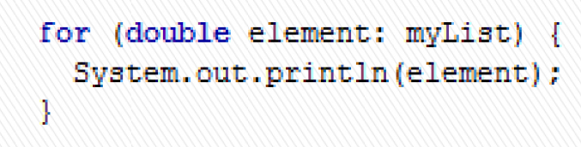
Array Processing: Enhanced For
JDK 1.5 introduced a new for loop, known as foreach loop or enhanced for loop
This enables you to traverse the complete array sequentially without using an index variable.
For example, the following code displays all the elements in the array myList:
double[] myList= {1.9, 2.9, 3.4, 3.5};

Slide 18
Array Processing: Copying Arrays
In Java, you can use assignment statements to copy primitive data type variables, but not arrays.
Assigning one array variable to another array variable actually copies one reference to another and makes both variables point to the same memory location.
There are three ways to copy arrays:
Use a loop to copy individual elements one by one.
Use the static arraycopy method in the System class.
Use the clone method to copy arrays; this will be introduced in "Inheritance and Polymorphism.

Slide 19
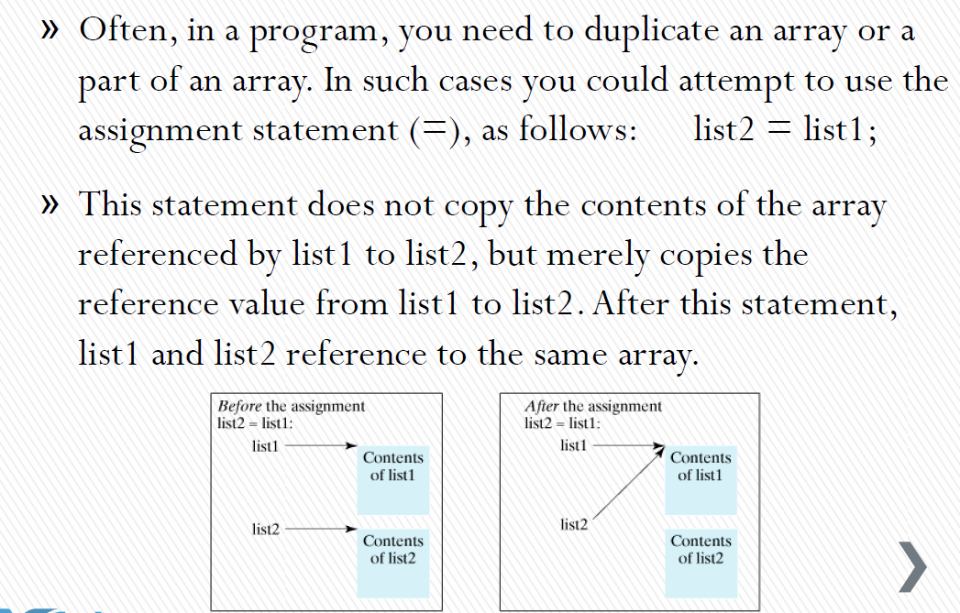
Array Processing: Copying Arrays

Slide 20
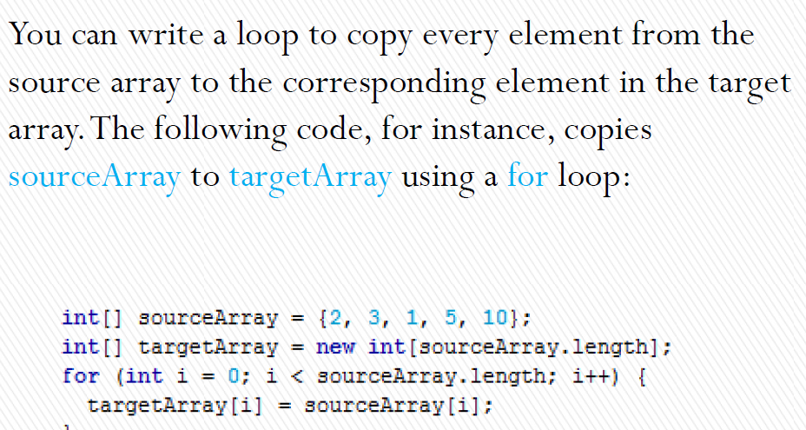
Array Processing: Copying Arrays

Slide 21
Array Processing: Copying Arrays
Another approach is to use the arraycopy method in the java.lang.System class to copy arrays instead of using a loop. The syntax for arraycopy is shown below:
arraycopy(sourceArray, srcPos, targetArray, tarPos, length);
The parameters srcPos and tarPos indicate the starting positions in source Array and target Array, respectively. The number of elements copied from source Array to target Array is indicated by length.
For example, you can rewrite the loop using the following statement:
System.arraycopy(sourceArray, 0, targetArray, 0, sourceArray.length);

Slide 22
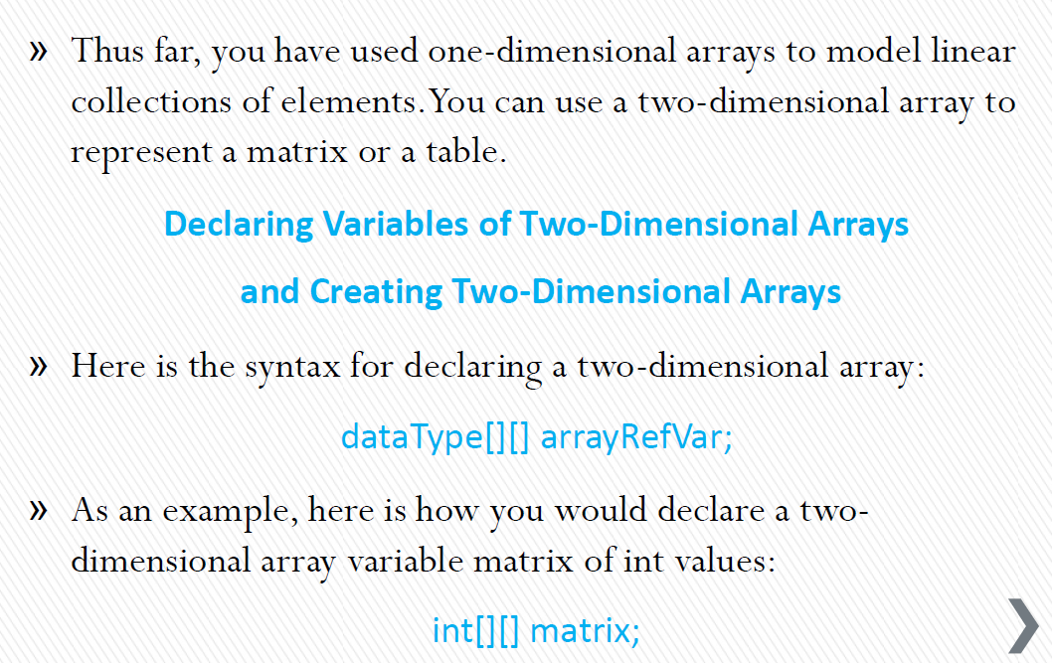
Array Processing: Two Dimensional Arrays

Slide 23
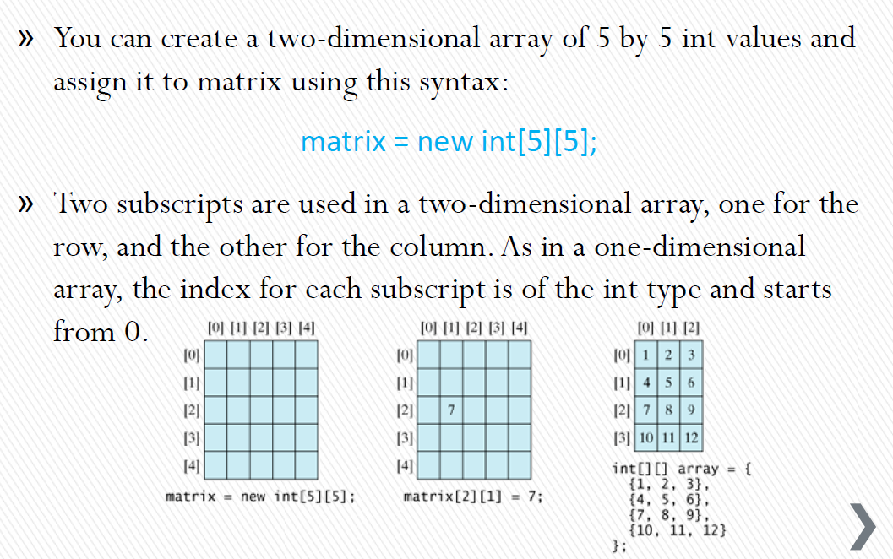
Array Processing: Two Dimensional Arrays

Slide 24
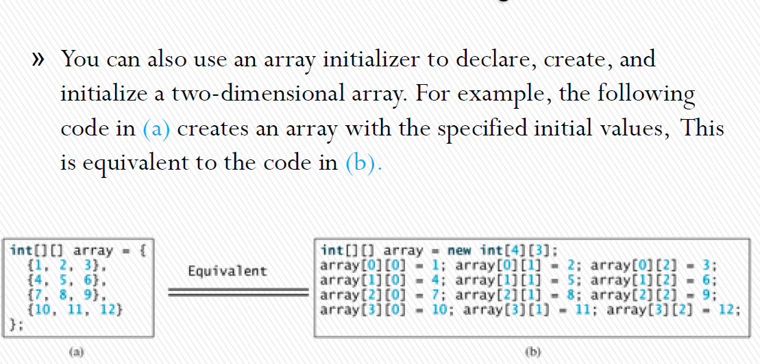
Array Processing: Two Dimensional Arrays

Slide 25
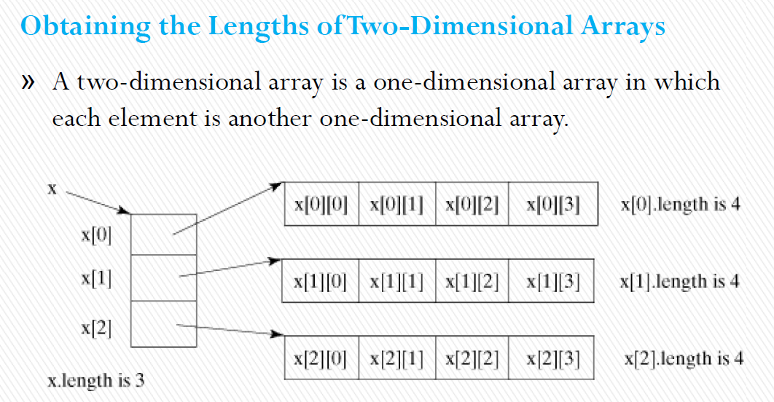
Array Processing: Two Dimensional Arrays

Slide 26
Array Processing: Array List – Revist while Doing Collections
Standard Java arrays are of a fixed length.
After arrays are created, they cannot grow or shrink, which means we can not resize Arrays.
Arrays are useful when we know in advance how many elements the array is to hold.
ArrayList is a collection which provides the implementation of resizable array.
ArrayList supports dynamic arrays that can grow as needed.
Array lists are created with an initial size.
When this size is exceeded, the collection is automatically enlarged.
When objects are removed, the array may be shrunk

Slide 27
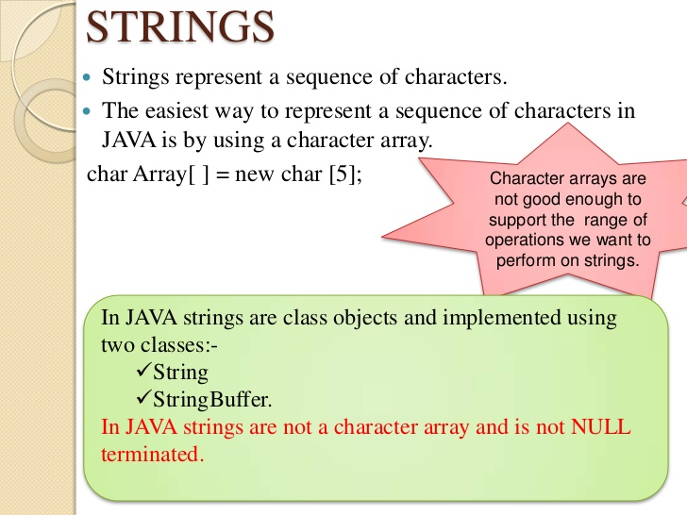
Java-STRING
The one which threads an object path!

Slide 28
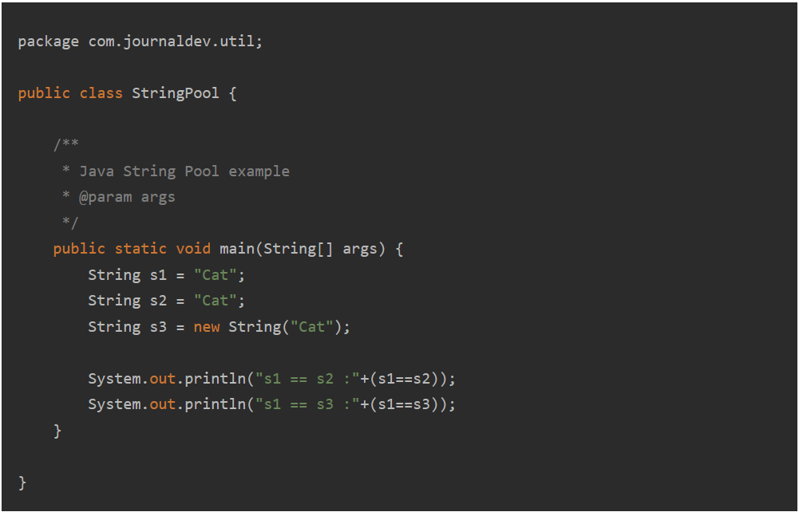
Strings in Java – Guess The Output

Slide 29
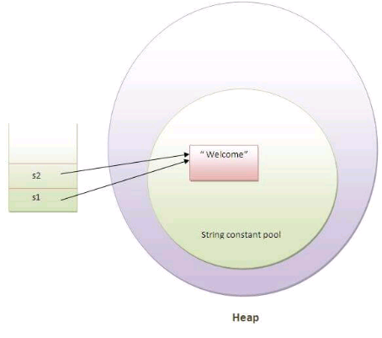
Dive in – String Pool – Huh??
As the name suggests, String Pool in java is a pool of Strings stored in Java Heap Memory. We know that String is special class in java and we can create String object using new operator as well as providing values in double quotes.
String Pool is possible only because String is immutable in Java and it’s implementation of String interning concept.
String pool helps in saving a lot of space for Java Runtime although it takes more time to create the String.
When we use double quotes to create a String, it first looks for String with same value in the String pool, if found it just returns the reference else it creates a new String in the pool and then returns the reference.
In the above example, only one object will be created. Firstly, JVM will not find any string object with the value "Welcome" in string constant pool, that is why it will create a new object. After that it will find the string with the value "Welcome" in the pool, it will not create a new object but will return the reference to the same instance.

Slide 30
Strings in Java
Strings, which are widely used in Java programming, are a sequence of characters.
In Java programming language, strings are treated as objects.
The Java platform provides the String class to create and manipulate strings.
There are two ways to create String object:
By string literal
By new keyword
String mystring ="welcome";
String s1="Welcome";
String s2="Welcome";//It doesn't create a new instance
In the above example, only one object will be created. Firstly, JVM will not find any string object with the value "Welcome" in string constant pool, that is why it will create a new object. After that it will find the string with the value "Welcome" in the pool, it will not create a new object but will return the reference to the same instance.

Slide 31
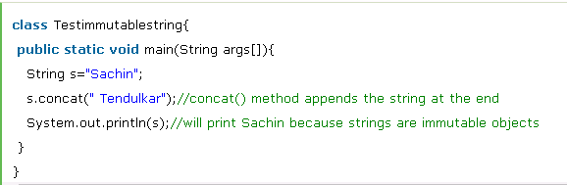
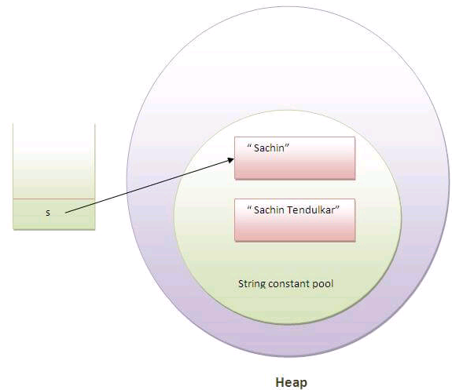
Immutability of Strings
In java, string objects are immutable. Immutable simply means unmodifiable or unchangeable.
Once string object is created its data or state can't be changed but a new string object is created.
Let's try to understand the immutability concept by the example given below:
As you can see in the above figure that two objects are created but s reference variable still refers to "Sachin" not to "Sachin Tendulkar".

Slide 32
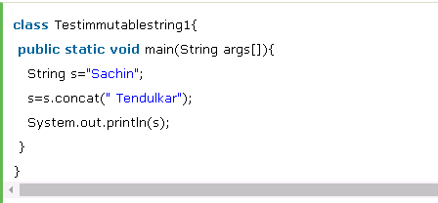
Immutability of Strings – Why?
Because java uses the concept of string literal.
Suppose there are 5 reference variables, all refers to one object "sachin".
If one reference variable changes the value of the object, it will be affected to all the reference variables.
That is why string objects are immutable in java.

Slide 33
String Comparison
We can compare string in java on the basis of content and reference.
It is used in authentication (by equals() method), sorting (by compareTo() method), reference matching (by == operator) etc.
There are three ways to compare string in java:
By equals() method
By = = operator
By compareTo() method

Slide 34
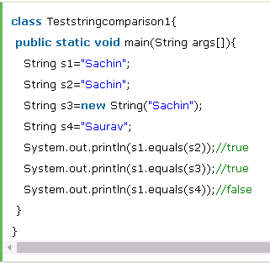
1. String compare by equals() method
The String equals() method compares the original content of the string. It compares values of string for equality. String class provides two methods:
public boolean equals(Object another) compares this string to the specified object.
public boolean equalsIgnoreCase(String another) compares this String to another string, ignoring case.

Slide 35
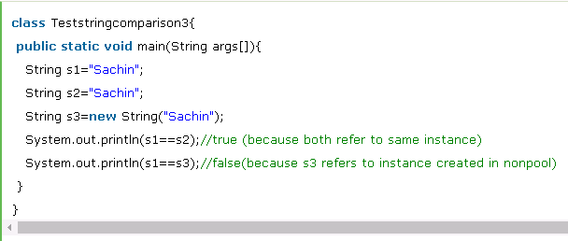
2. String compare by == operator
The = = operator compares references not values.

Slide 36
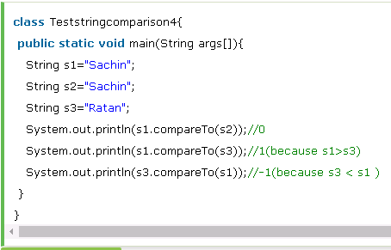
3. String compare by compareTo() method
The String compareTo() method compares values lexicographically and returns an integer value that describes if first string is less than, equal to or greater than second string.
Suppose s1 and s2 are two string variables. If:
s1 == s2 :0
s1 > s2 :positive value
s1 < s2 :negative value

Slide 37
String Manipulations
Concatenation:
In java, string concatenation forms a new string that is the combination of multiple strings. There are two ways to concat string in java:
By + (string concatenation) operator
By concat() method
Substring
You can get substring from the given string object by one of the two methods:
public String substring(int startIndex): This method returns new String object containing the substring of the given string from specified startIndex (inclusive).
public String substring(int startIndex, int endIndex): This method returns new String object containing the substring of the given string from specified startIndex to endIndex.

Slide 38
String Class - Methods
Method | Description
Java String toUpperCase() and toLowerCase() method | String s="Sachin"; System.out.println(s.toUpperCase());//SACHIN System.out.println(s.toLowerCase());//sachin System.out.println(s);//Sachin(no change in original) .
Java String trim() method | String s=" Sachin "; System.out.println(s);// Sachin System.out.println(s.trim());//Sachin .
Java String startsWith() and endsWith() method | String s="Sachin"; System.out.println(s.startsWith("Sa"));//true System.out.println(s.endsWith("n"));//true
Java String charAt() method | String s="Sachin"; System.out.println(s.charAt(0));//S System.out.println(s.charAt(3));//h
Java String length() method | String s="Sachin"; System.out.println(s.length());//6
Java String intern() method | String s=new String("Sachin"); String s2=s.intern(); System.out.println(s2);//Sachin
Java String replace() method | String s1="Java is a programming language. Java is a platform. Java is an Island."; String replaceString=s1.replace("Java","Kava");//replaces all occurrences of "Java" to "Kava" System.out.println(replaceString);
Notes:
A pool of strings, initially empty, is maintained privately by the class String.
When the intern method is invoked, if the pool already contains a string equal to this String object as determined by the equals(Object) method, then the string from the pool is returned. Otherwise, this String object is added to the pool and a reference to this String object is returned.

Slide 39
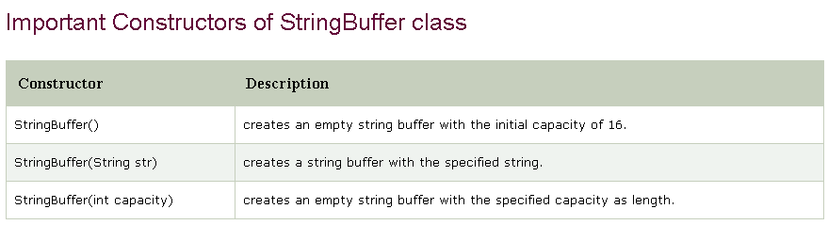
StringBuffer Class
Java StringBuffer class is used to create mutable (modifiable) string. The StringBuffer class in java is same as String class except it is mutable i.e. it can be changed.
Note: Java StringBuffer class is thread-safe i.e. multiple threads cannot access it simultaneously. So it is safe and will result in an order.

Slide 40
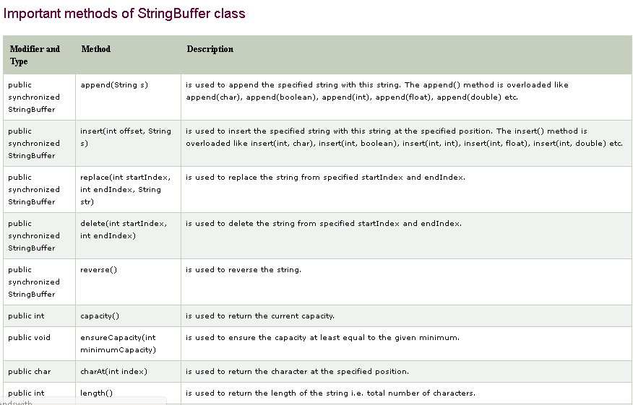
StringBuffer Class

Slide 41
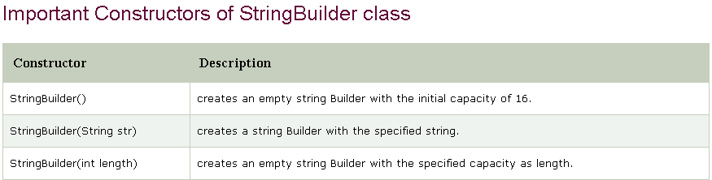
StringBuilder Class
Java StringBuilder class is used to create mutable (modifiable) string. The Java StringBuilder class is same as StringBuffer class except that it is non-synchronized. It is available since JDK 1.5.

Slide 42
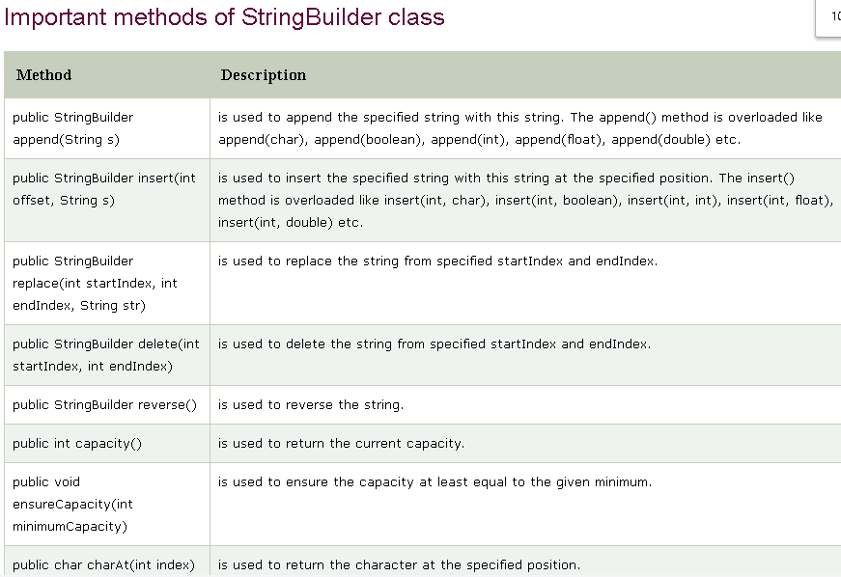
StringBuilder Class

Slide 43
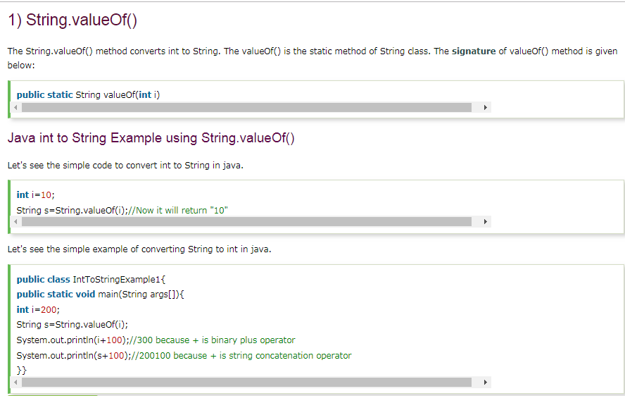
String Conversions

Slide 44
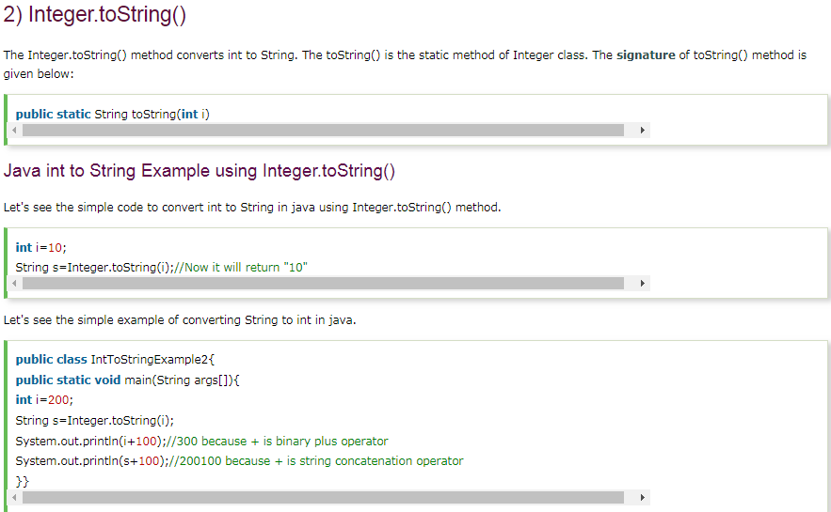
String Conversions

Slide 45
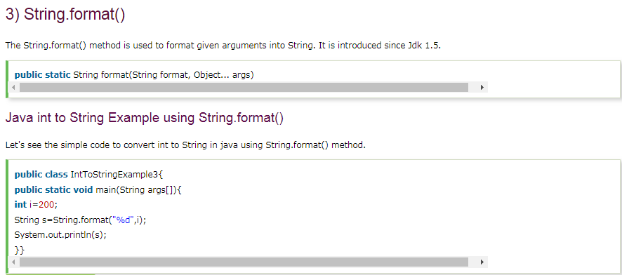
String Conversions

Slide 46
String vs StringBuffer vs StringBuilder
String
String is immutable ( once created can not be changed )object . The object created as a String is stored in the Constant String Pool. Every immutable object in Java is thread safe ,that implies String is also thread safe . String can not be used by two threads simultaneously. String once assigned can not be changed
StringBuilder
StringBuilder is same as the StringBuffer , that is it stores the object in heap and it can also be modified . The main difference between the StringBuffer and StringBuilder is that StringBuilder is also not thread safe. StringBuilder is fast as it is not thread safe .
StringBuffer
StringBuffer is mutable means one can change the value of the object . The object created through StringBuffer is stored in the heap. each method in StringBuffer is synchronized that is StringBuffer is thread safe

Slide 47

Questions ?
You can contact me @
avadekkedhil@wilp.bits-pilani.ac.in
9881300394

